Slide 1
Python

Slide 2


Slide 3
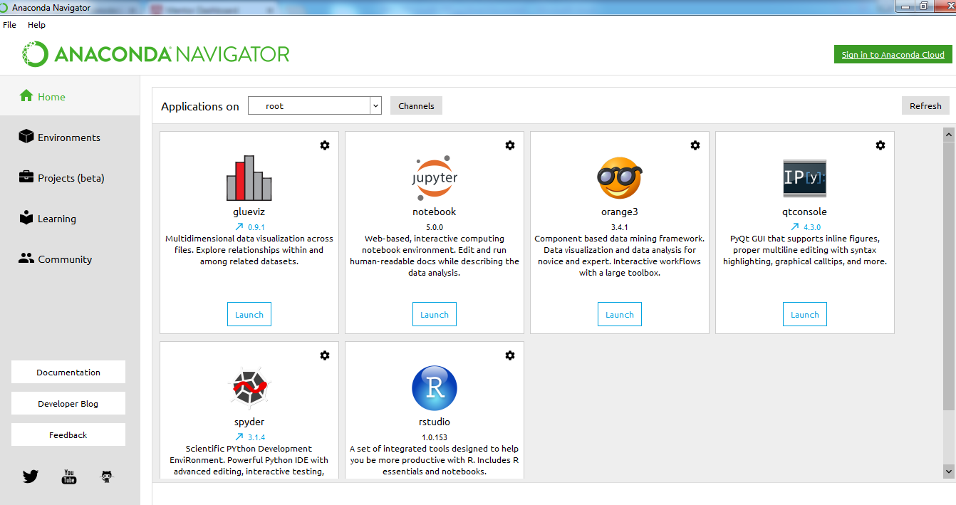
Anaconda Navigator

Slide 4
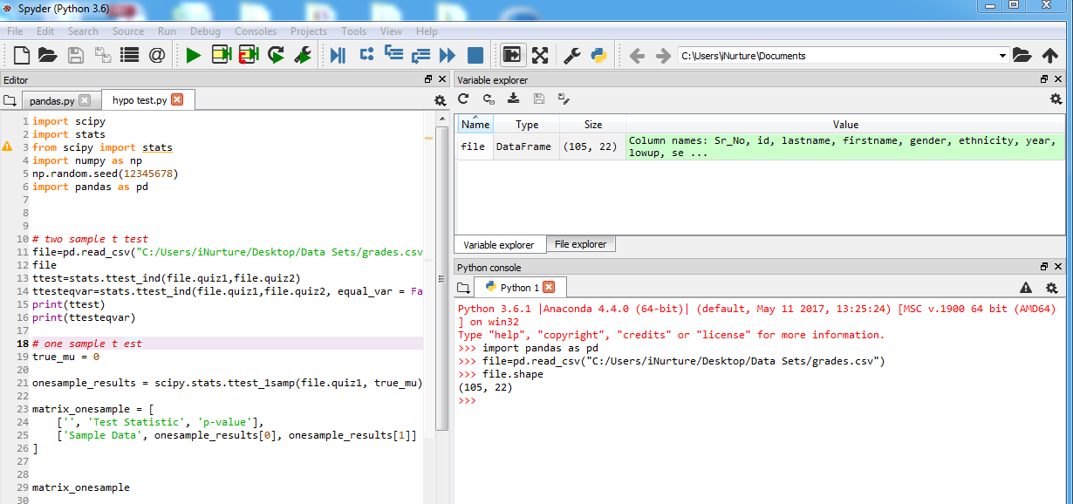
Spyder

Slide 5
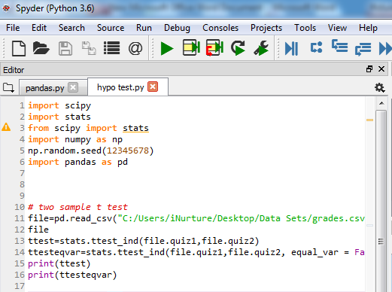
Script

Slide 6
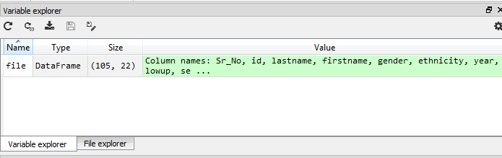
R like Global Environment

Slide 7
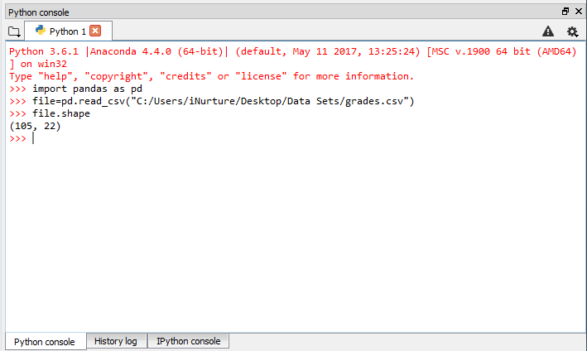
R like console

Slide 8
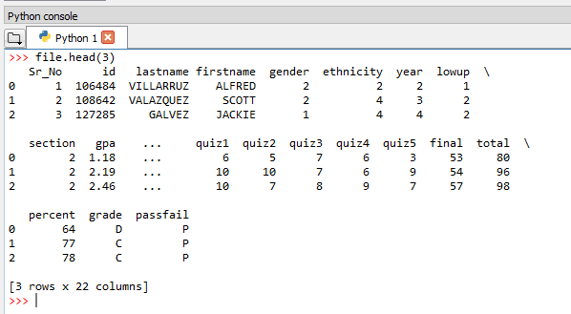
R like head(3)

Slide 9
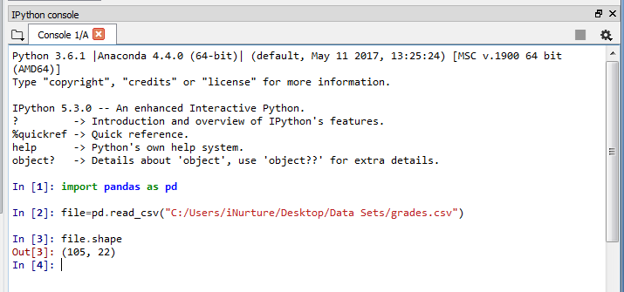
IPython console

Slide 10
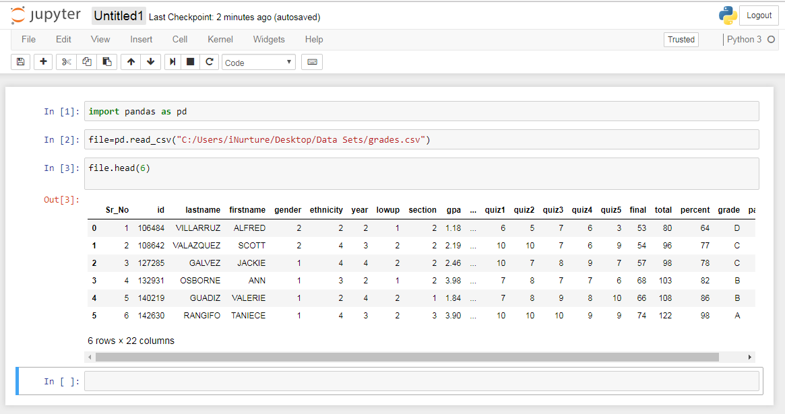
jupyter

Slide 11
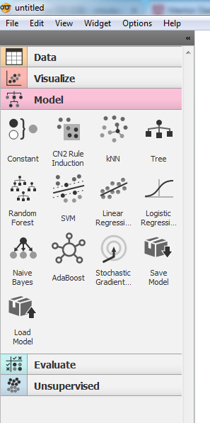
orange: Data Mining Tool

Slide 12

Go to help → Example

Slide 13
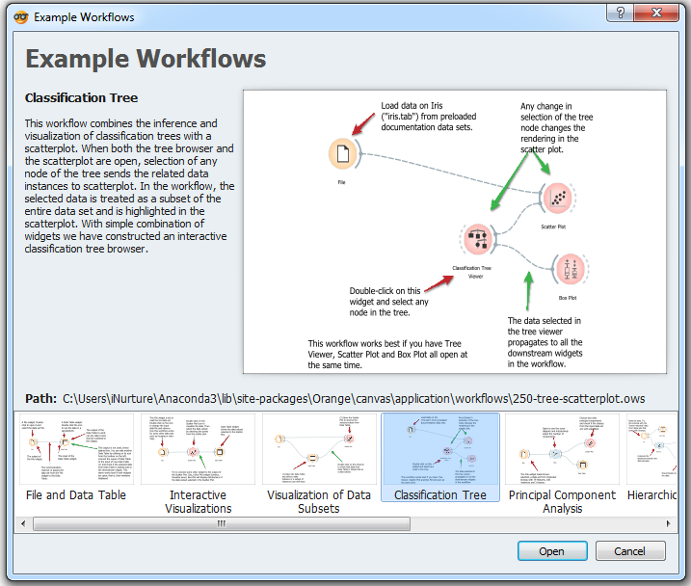
Example Classification Tree

Slide 14
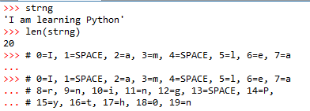


String
String is immutable means once created it can not be changed
Parenthesis is immaterial

Slide 15
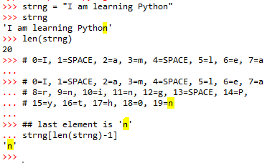

String

Slide 16
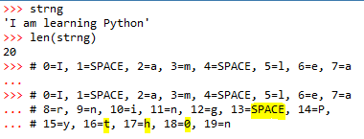
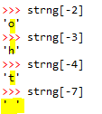
String
20 is length
20-2=18 is ‘o’
20 is length
20-3=17 is ‘h’
Same as strng[-2]
20 is length
20-2=16 is ‘t’
20 is length
20-7=13 is ‘ ’ space

Slide 17

String
Start from 0 which is I
Last number 2, which is ‘a’ WILL NOT BE INCLUDED
Goes to 1 which is space

Slide 18

String
Start from 3 which is m
Last number 6, which is ‘e’ WILL NOT BE INCLUDED
Goes to 4 & 5 which are space & l

Slide 19

String
Start from 5 which is l
Last number 8, which is ‘r’ WILL NOT BE INCLUDED
Goes to 6 & 7 which are e & a

Slide 20

String
Start from 0 which is I
Last number 4, which is space WILL NOT BE INCLUDED
Goes to 3 which is m

Slide 21

String
Start from 17 which is h
If after : nothing is mentioned, it will go up to last

Slide 22

String
Start from 1st element goes up to last element

Slide 23
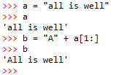

Replacing a by A Adding two strings
A is taking place of a in string a, look how a[1:] is playing role (ignoring a in all)

Slide 24

Tuple
0
1
2
3
Space between two elements does not matter

Slide 25
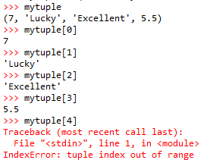
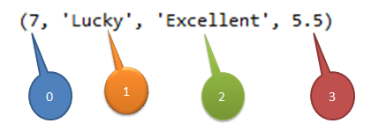
Tuple

Slide 26
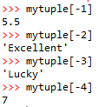
Tuple
4-1 = 3rd index is 5.5
4-2 = 2nd index is Excellent
4-3 = 1st index is Lucky
4-4 = 0th index is 7

Slide 27

Tuple
0 is 7, 1 is Lucky; 2 which is Excellent is IGNORED

Slide 28

Tuple: adding word ‘Wonderful’
Note the signs +=

Slide 29
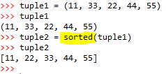
Tuple: sorting

Slide 30
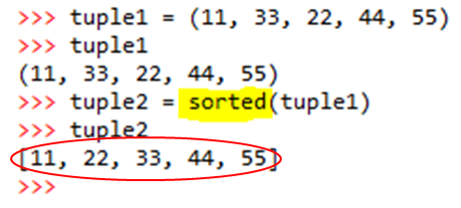

Sorted tuple is a list
Note the brackets!

Slide 31



Integer vs Tuple
a is holding an integer 4
b is a tuple having 4 in it

Slide 32
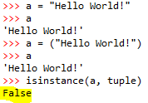


String vs tuple

Slide 33
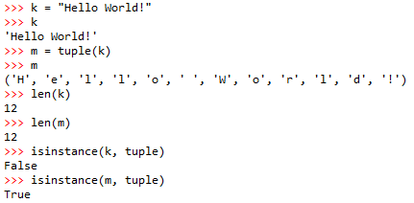
String into tuple

Slide 34
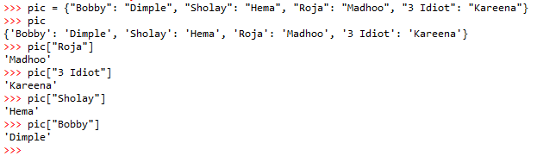
Dictionary
Key
Value
Value
Value
Key
Key
Key
Value

Slide 35

You can change Value to a key
Hema replaced by Jaya

Slide 36
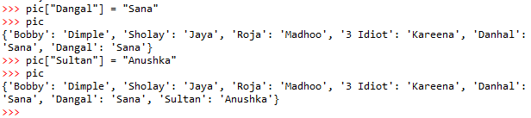

Create new pair
New Keys
New Values
New Dictionary

Slide 37

Remove any item say, Sultan:Anhushka
Use command <name>.pop
ONLY key is to be mentioned
New Dictionary

Slide 38
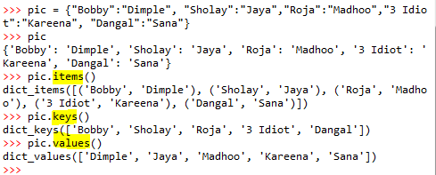
Retrieve Items, Keys, Values

Slide 39
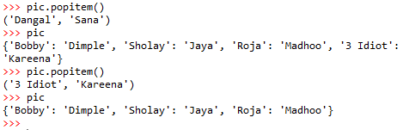
Removing LAST items

Slide 40
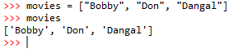
List of movies

Slide 41
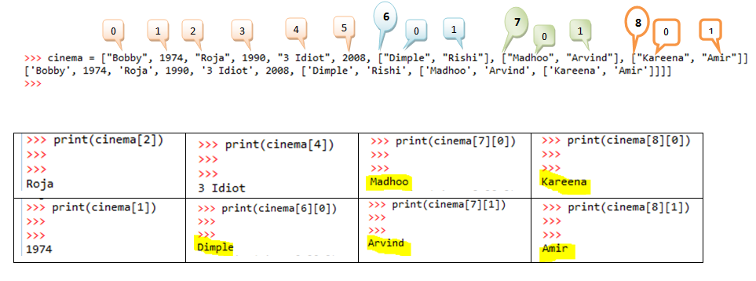
Lists

Slide 42
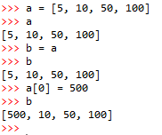
Alias
b is alias of a
Change in a is reflected in b

Slide 43
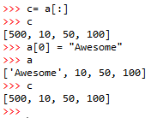
Clone
c is a clone
Change in a is not resulting change in c
b is alias of a

Slide 44
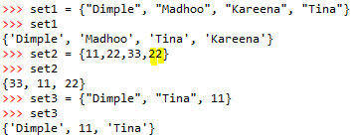

Sets
Duplicate item/s will be ignored

Slide 45

Union of 2 sets
Note the symbol | for union
Duplicates are ignored

Slide 46

Sets do not have orders

Slide 47
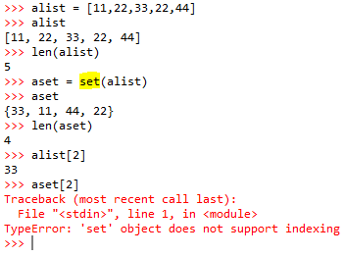
List into a Set
See usage of set
Duplicates are ignored in sets
Indexing is doable/possible in LIST
Sets are not indexed

Slide 48
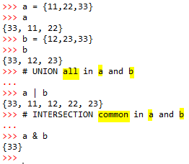
Union and Intersection of sets
See the symbols | for UNION and
& for INTERSETION

Slide 49
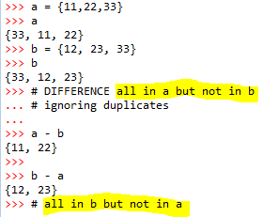
Difference
Bit tricky!
Difference a-b
All in a are 11, 22, 33 and those are not in b
are 11, 22 (33 is in b also, hence, ignored)
Difference b-a
All in b are 12, 23, 33 and those are not in a
are 12, 23 (33 is in a also, hence, ignored)

Slide 50
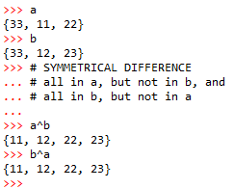

Symmetrical Difference
Indeed tricky!
a^b, a has 11, 22, 33 and 11 and 22 are not in b,
hence, included. Similarly, b has 12, 23, 33 and 12 and 22
are not in a, hence, included. Poor 33 is ignored!

Slide 51
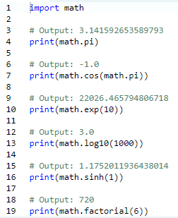
Something more in Math
Calling this package is important.

Slide 52
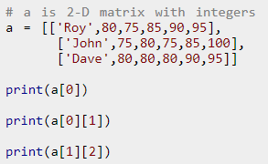
Matrix

Slide 53


Slide 54


